Slide 1
EUROPARC Atlantic Isles
Current work
Anita Prosser
Sheffield
16 August 2017

Slide 2
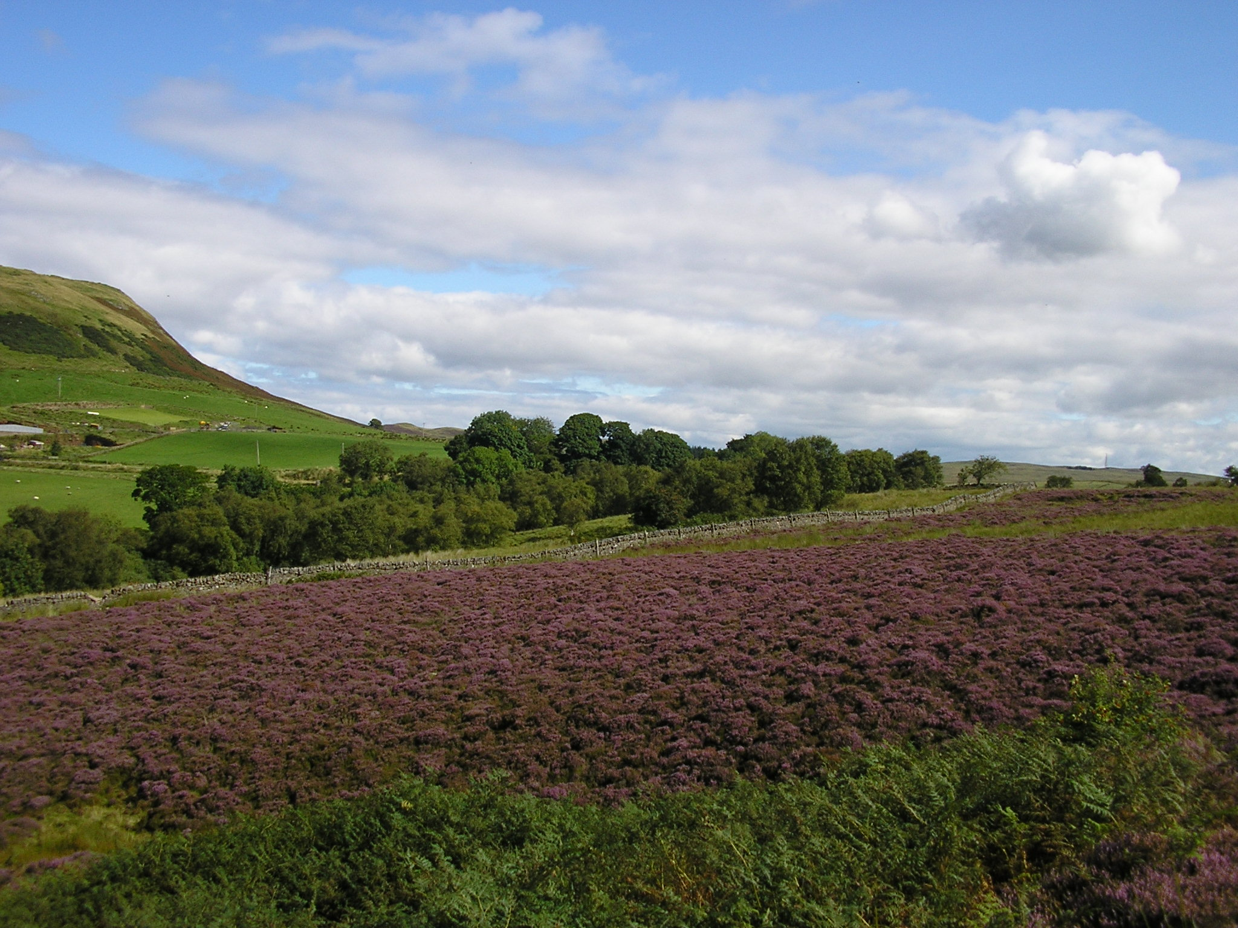
EAI Governance
Registered charity
Company limited by guarantee
Board of trustees
P/t Development Adviser
Notes:
EAI is a small organisation with the status of a registered charity and company limited by guarantee. The Board, representative of the membership, generates EAI’s priorities and business plan. Day-to-day work, including development, is coordinated by the Development Adviser.

Slide 3
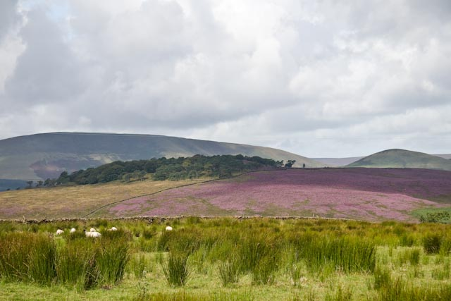
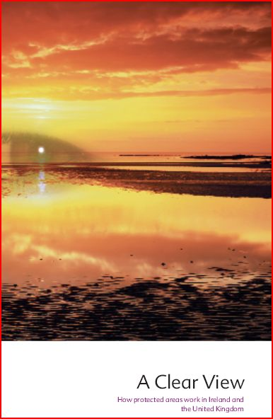
EAI membership
National Parks
Areas of Outstanding Natural
  Beauty
Regional Parks in Scotland
Statutory agencies
NGOs
Individuals
Notes:
EAI has a very broad membership that includes all designations of protected landscapes, as well as other organisations and stakeholders with an interest in the management and stewardship of protected areas, as well as nature conservation. This range, together with our UK wide and European dimensions, is the key difference to other umbrella bodies such as ANPA and NAAONBs.

Slide 4
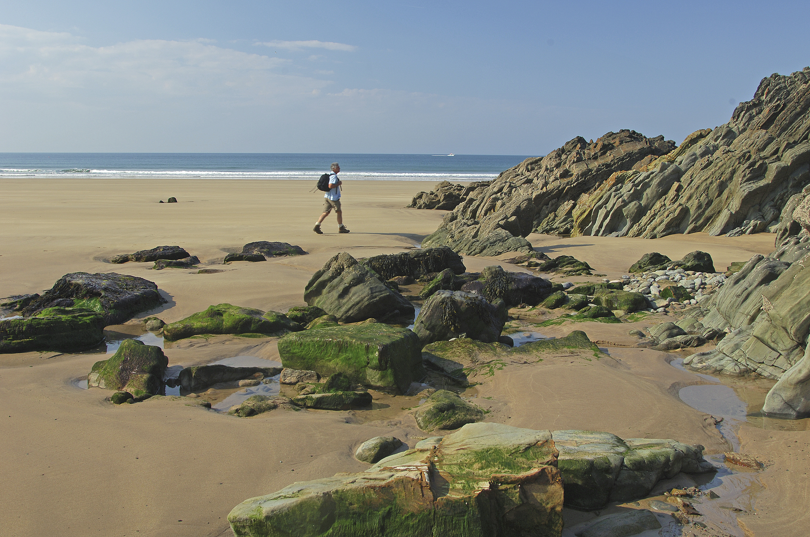
Multi-Country EAI
The UK
England, Scotland, Wales and Northern Ireland
Republic of Ireland
Iceland
European dimension
Notes:
EAI brings together people and organisations from the four countries of the UK. As devolution has progressed and different approaches have emerged this has proved to be particularly valuable for sharing expertise and information. Indeed, the three statutory agencies in Great Britain have commented on the value of this. As part of a bigger Federation there is a European dimension to our work, which is reflected in seminars etc.

Slide 5
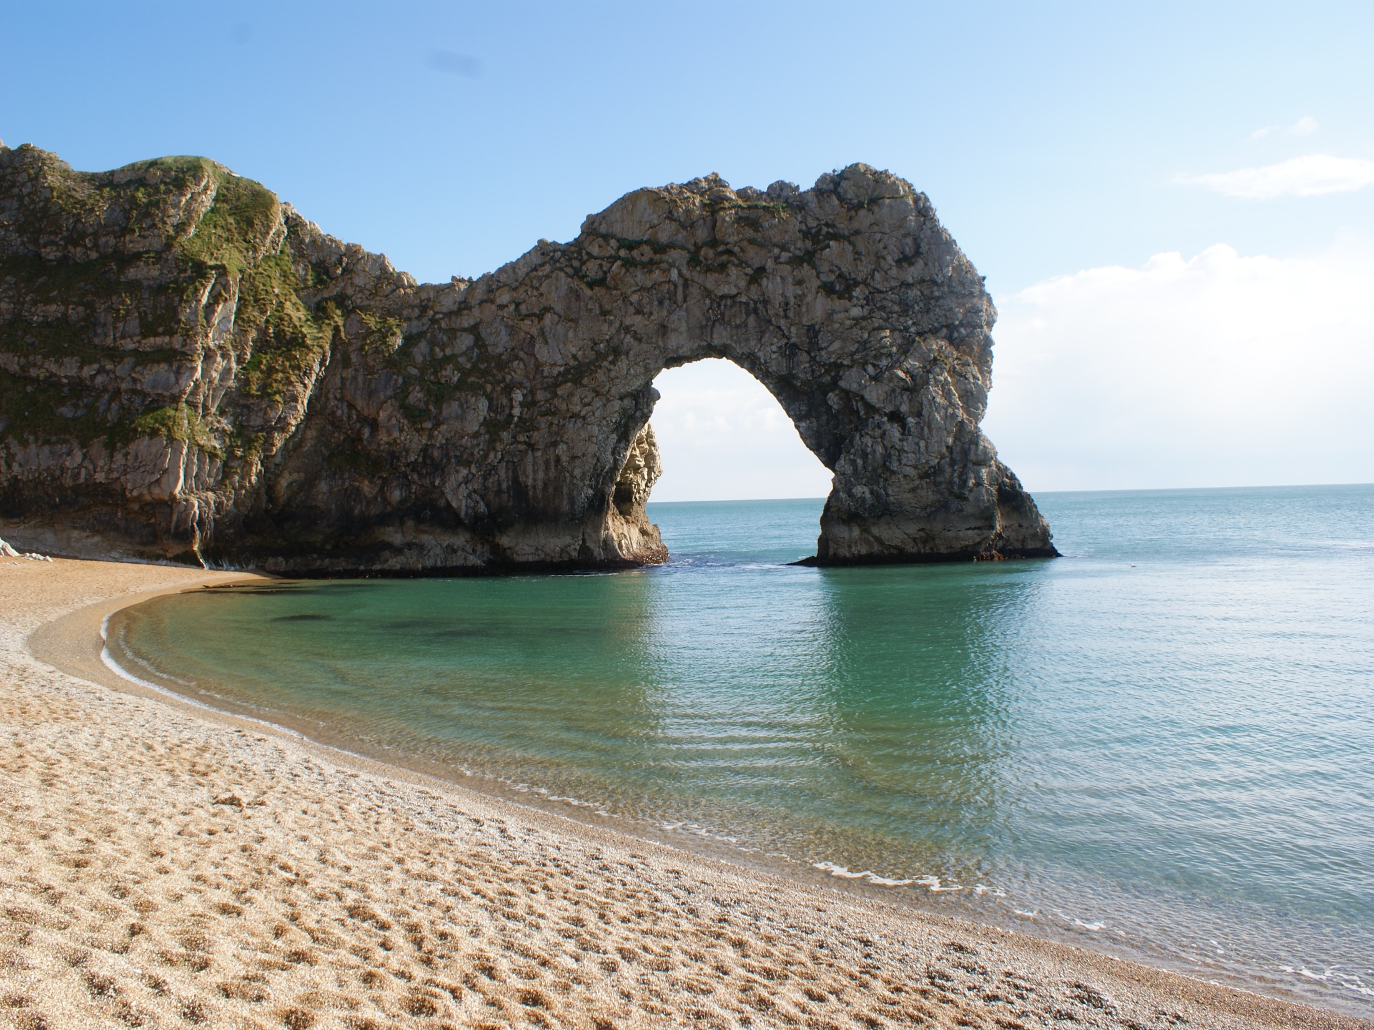
Outline
Background information
What we’re doing now
The future

Slide 6
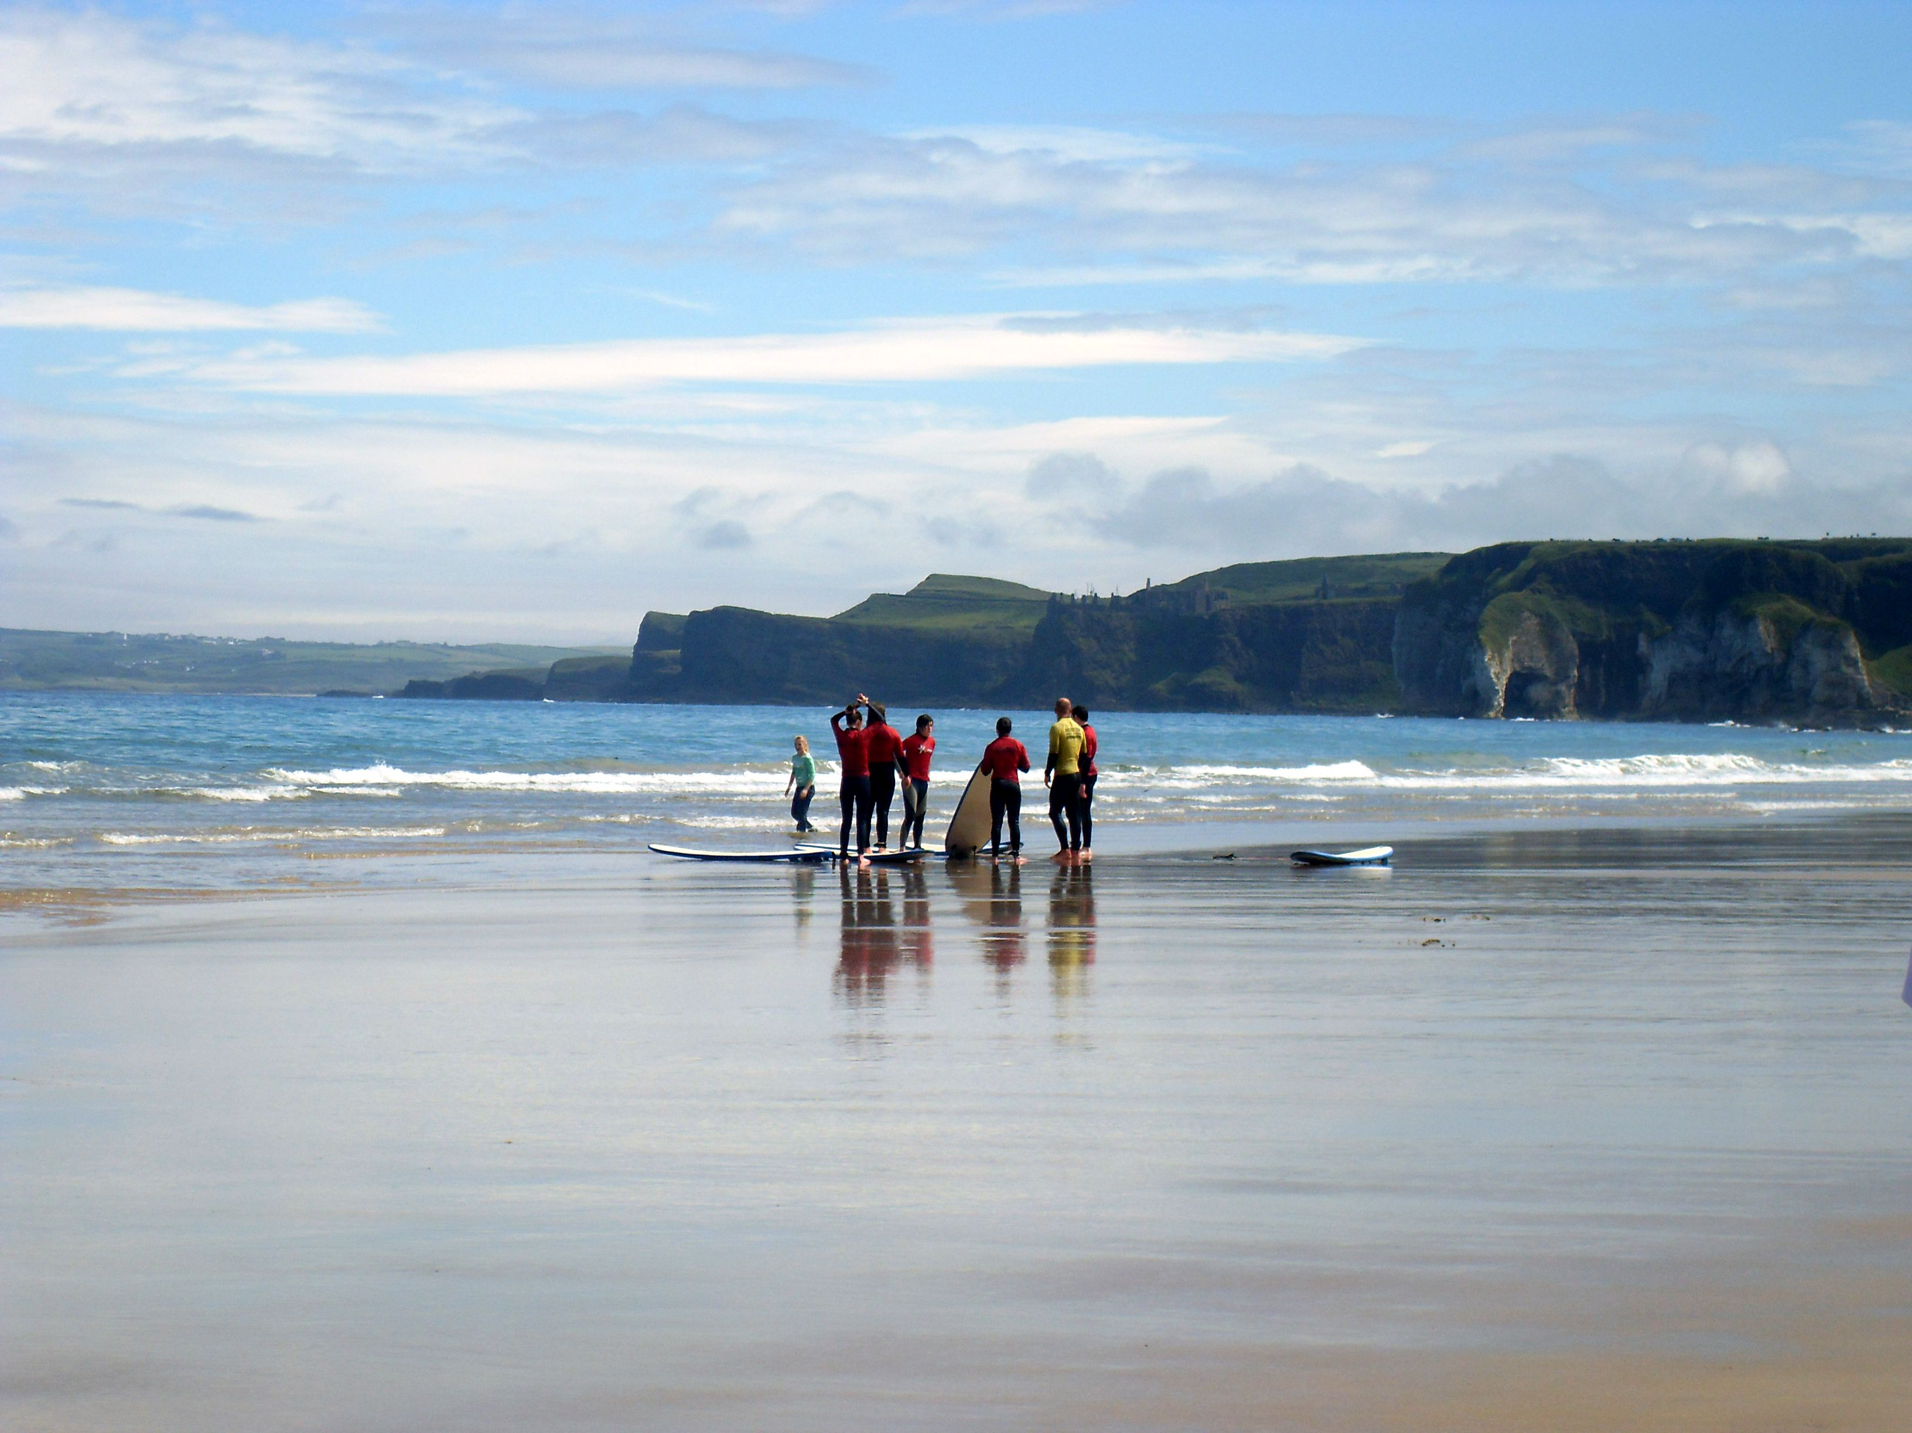
EAI Funding
Membership fees
Grants from statutory agencies (SNH, NRW, NE)
Projects (Erasmus+)
Sponsorship

Slide 7
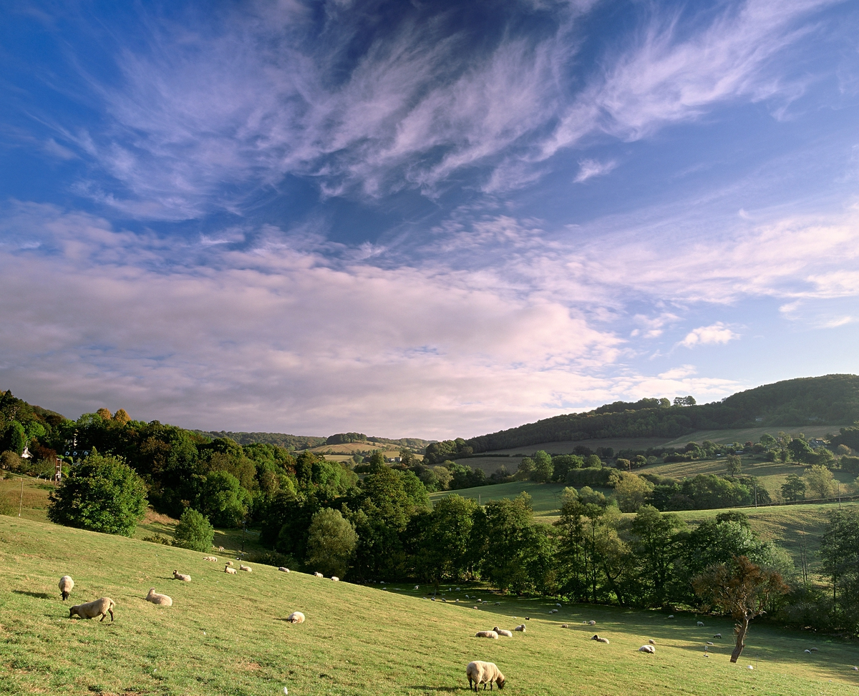
What is EAI?
Section of the EUROPARC Federation
Promote good practice and contribute to the effectiveness of protected area management
Organise training and the sharing of good practice in protected area management
Raise the profile and value of protected areas
Become a resilient organisation
Notes:
EAI is one of eight Sections of the Federation, which bring together members to pursue the aims of the Federation in their own countries or regions.
Developing new strategy
Some of the new areas of work
Egageing with the academic communities to link producted areas and Uni to look at research and research needs
Looking at health agenda and utilising experience from other parts of Europe

Slide 8
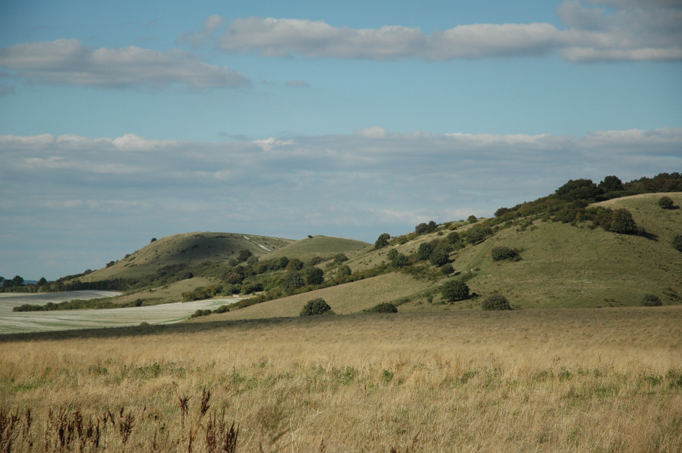
How we work
Sharing experience and expertise
Thought leadership
Thematic (net)working groups
Training opportunities / seminars
Communication

Slide 9
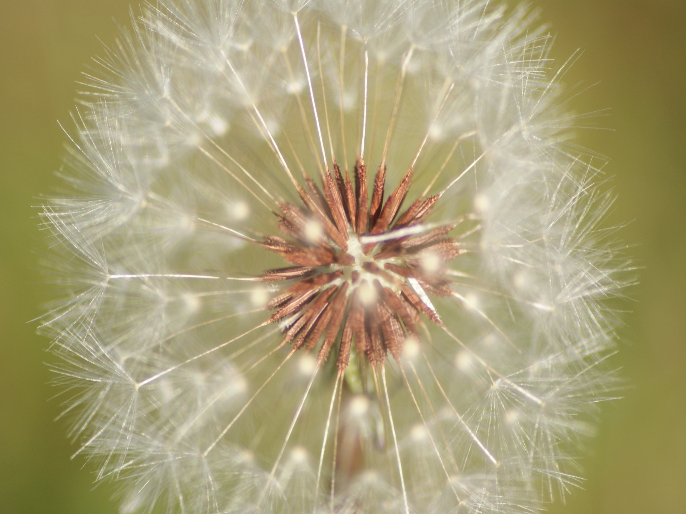
Past areas of work
Sustainable tourism / rural economy
Coastal conservation and marine planning
Volunteer management
Young rangers
Health and well-being

Slide 10
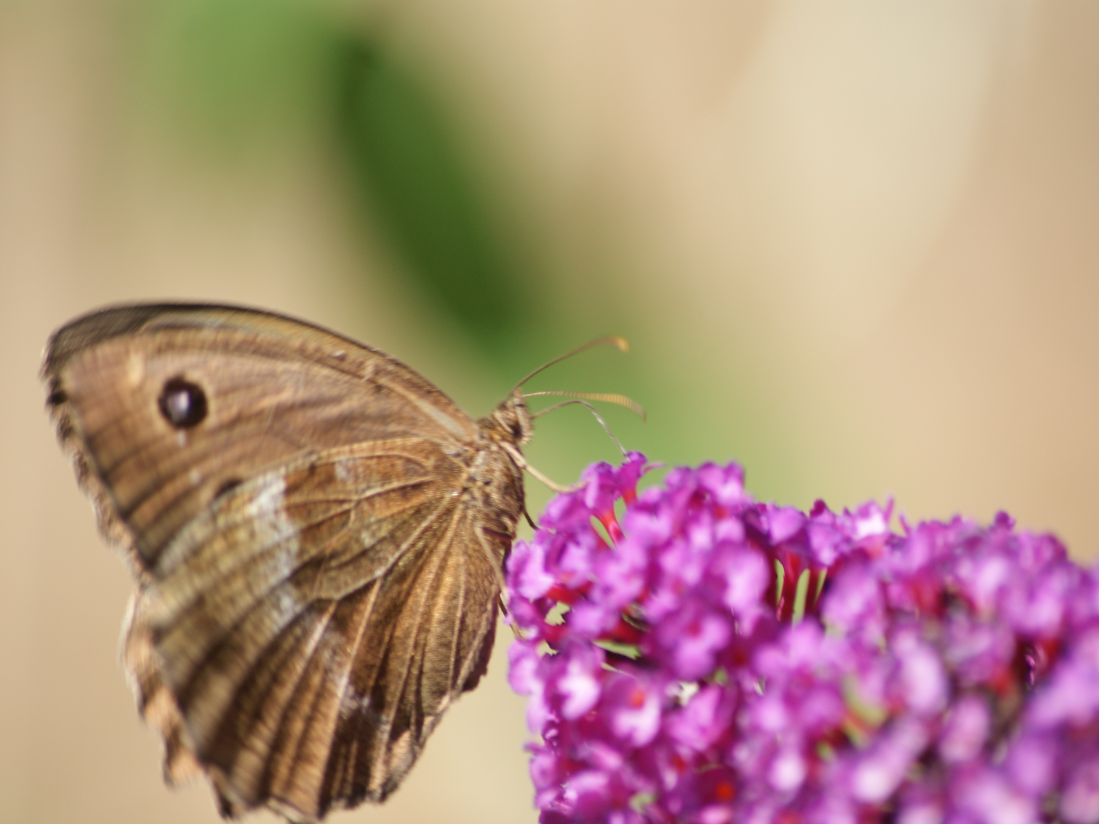
Partnership with Agencies
Webinar programme
Erasmus+ project PAVEL
Coastal & Marine Working Group
Annual members‘ meeting
Further identification of members‘ needs

Slide 11
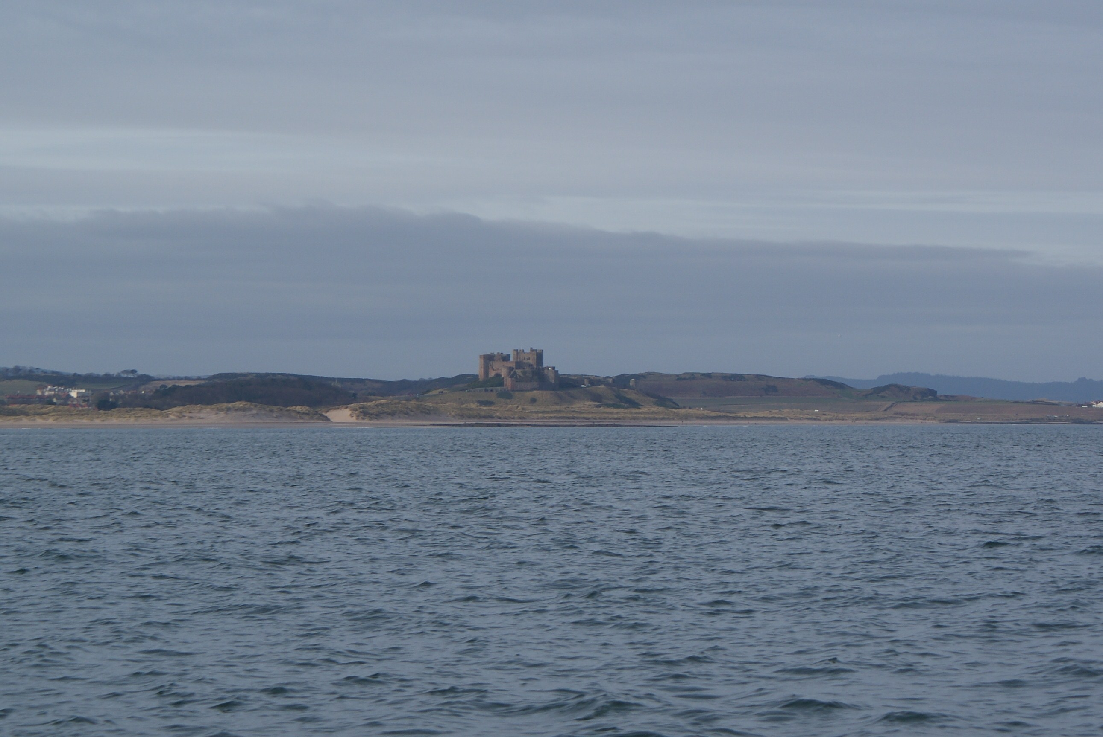
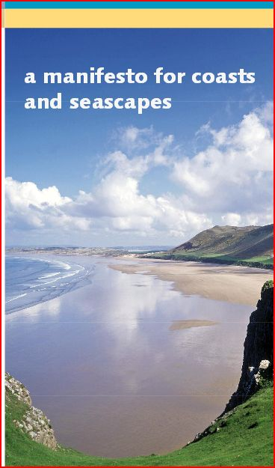
Coastal & Marine
Issues and challenges for
coastal protected landscapes
Connection & separation
between land and sea
Impact of development &
marine planning
Seascape Character Assessment
Heritage coasts
Notes:
EAI’s work is based on the manifesto for coasts and seascapes, which was signed together with six other organisations including the National Trust, CNP, NAAONB and CPRE. It calls for coasts and seascapes and the role that protected landscapes and seascapes play in the process of delivering a sustainable future for the coastal and marine environment to be embraced. We have also started to work in partnership with the Marine Management Organisation, and are also looking to build links with the Crown Estate. Marine planning has been the focus of the recent meetings, that have brought together national parks and AONBs.
Work on seascapes is important as they are a key resource in the marine environment. There is a need to identify their character and distinctiveness; to use principles of landscape characterisation; and identify conservation means;

Slide 12
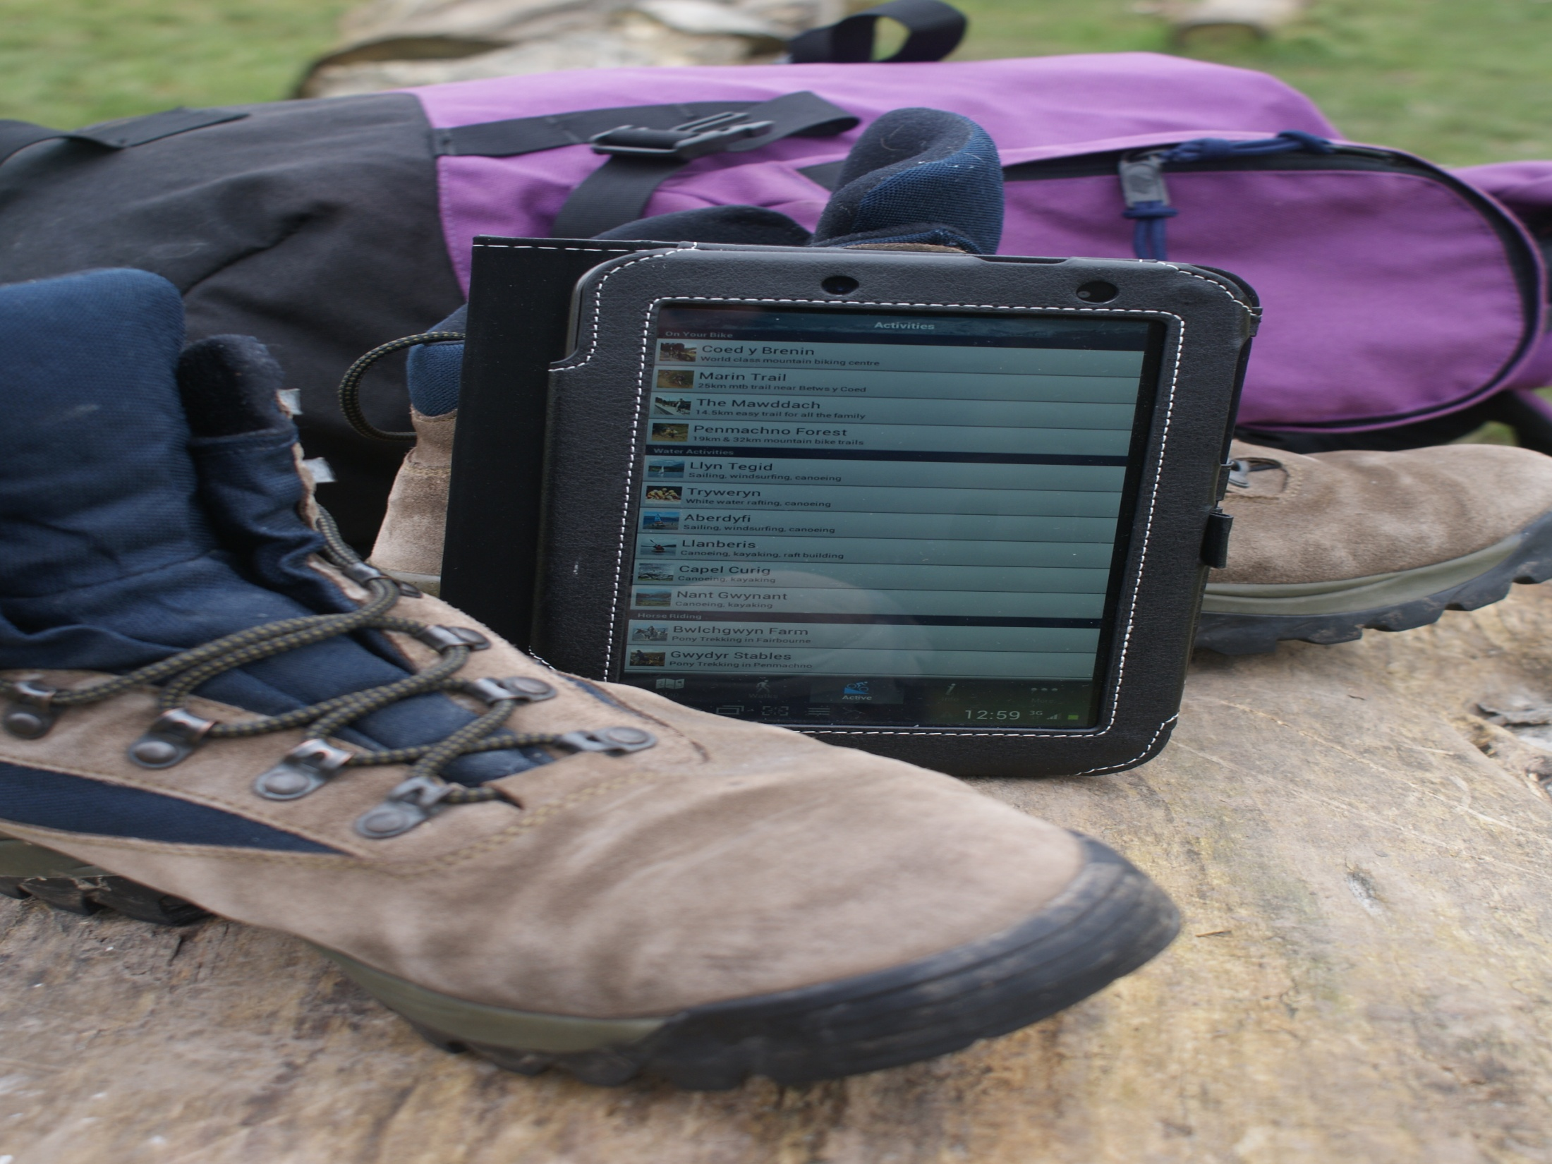

PAVEL
Protected Areas Vocational Education & Learning
Professional development
Partners in D, F, LV, NL
Notes:
Countries
7 day funded placements as individuals or a group
Germany
Latvia
Netherlands
France
Come to me if you have ideas.

Slide 13
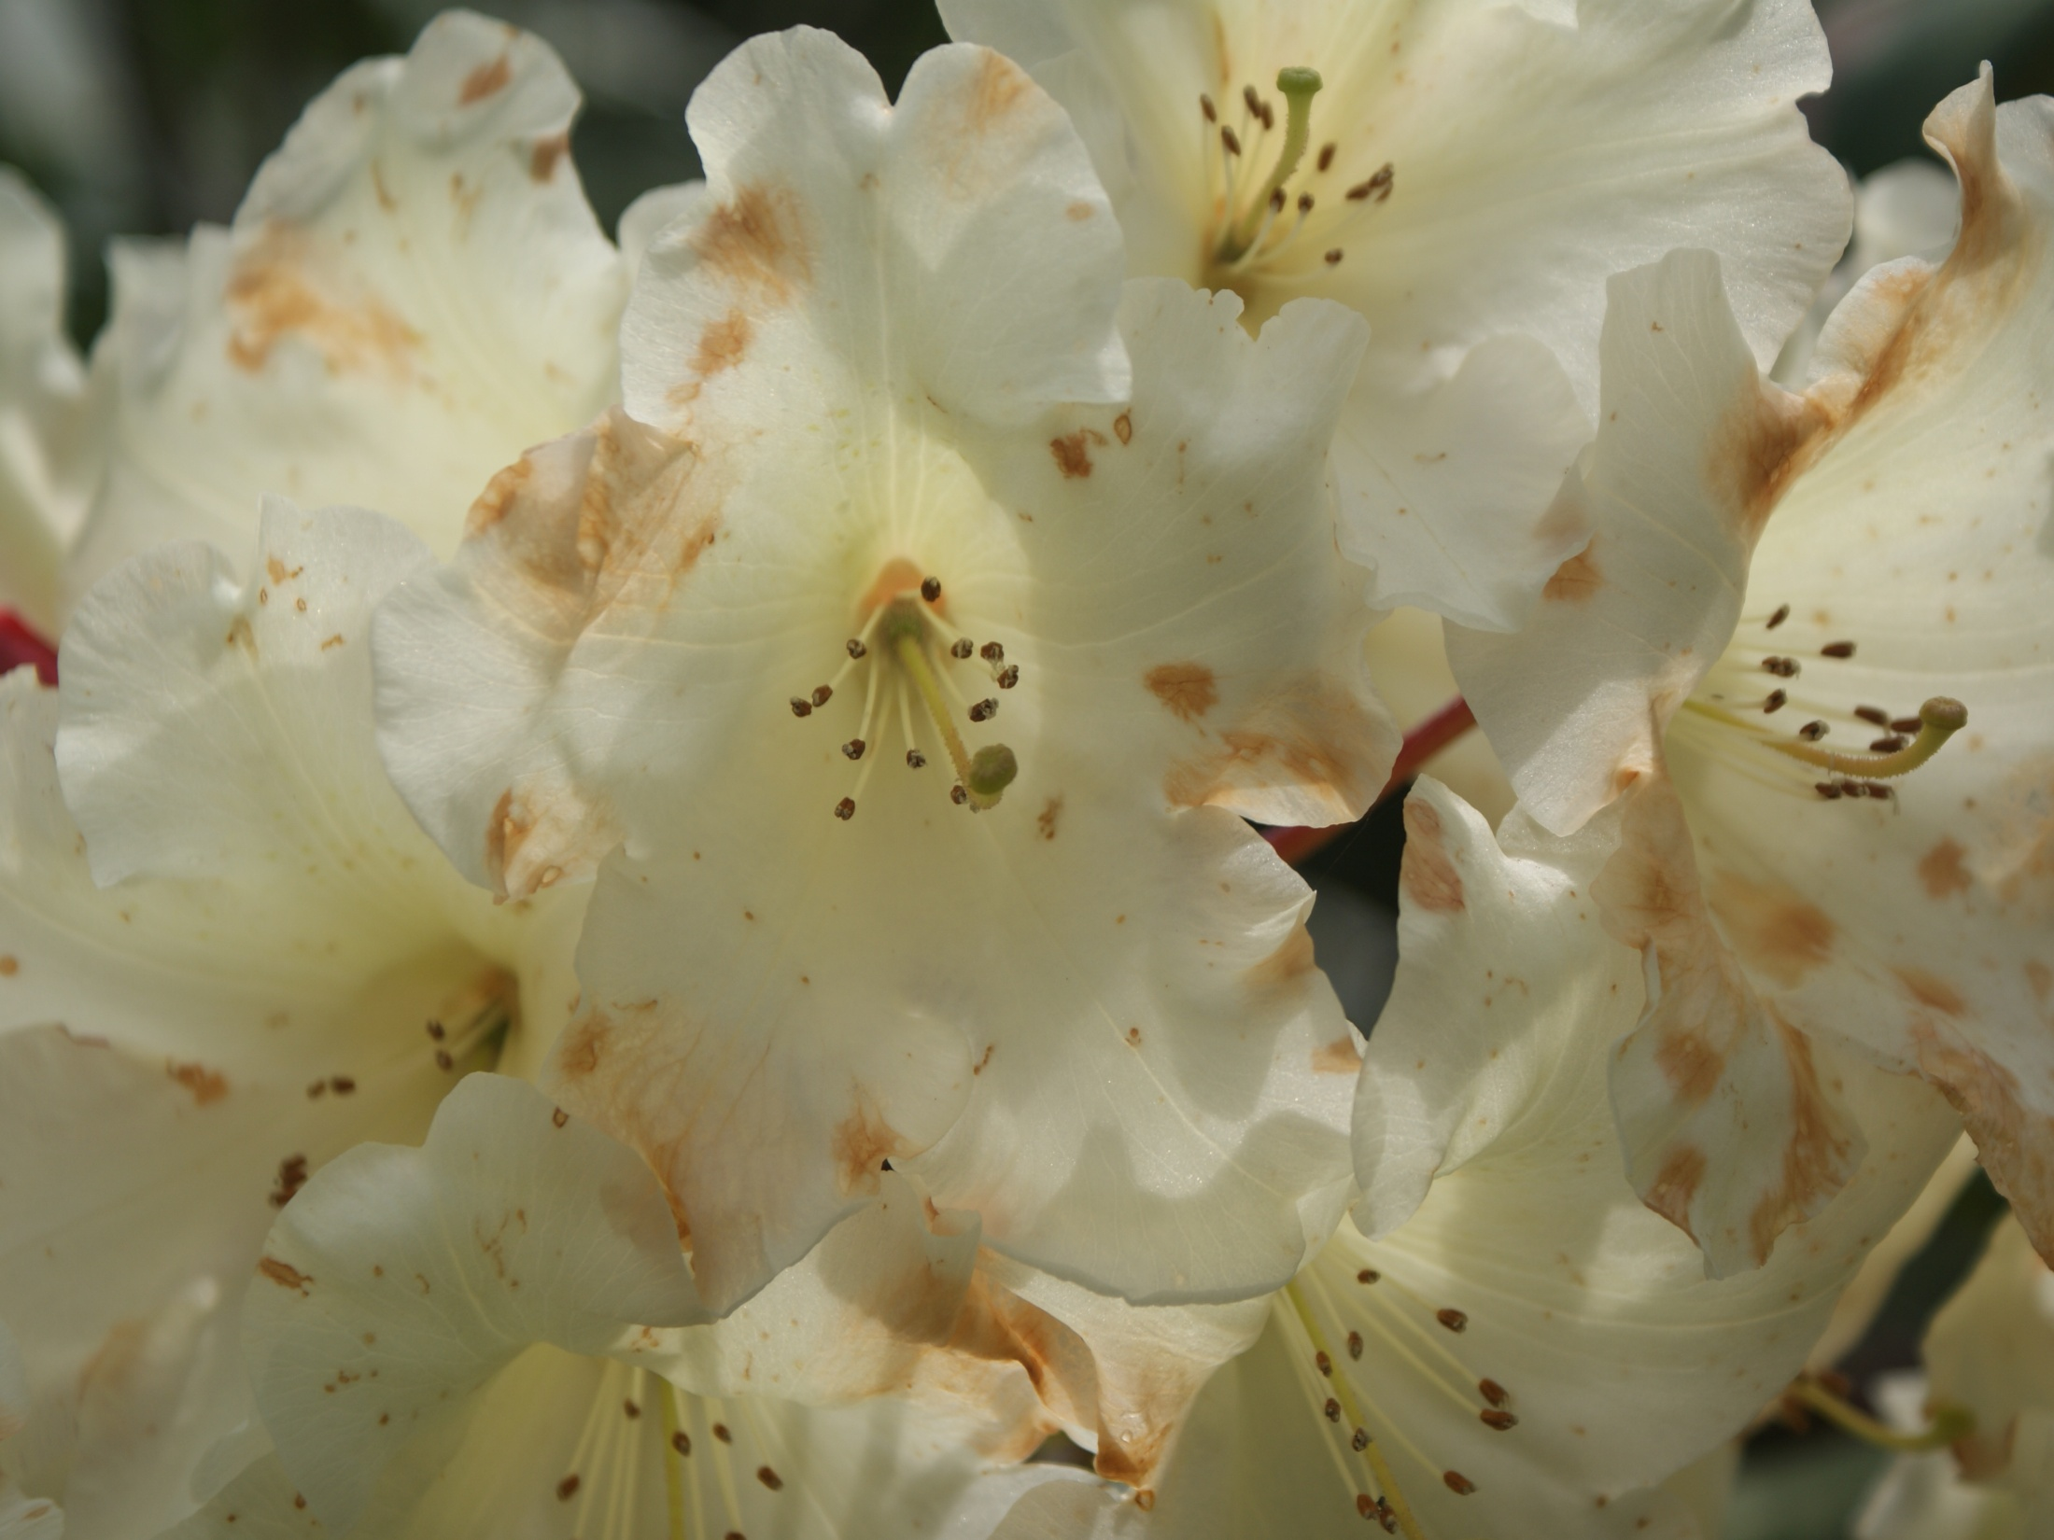
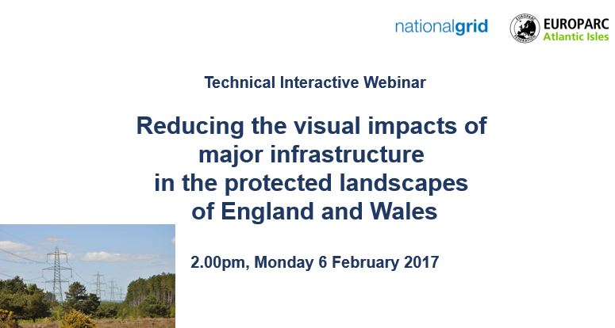
Webinar Programme

Slide 14
Best practice
Designated landscapes
Landscape change
Landscape management
Landscapes and people
Seascapes
Climate change

Slide 15
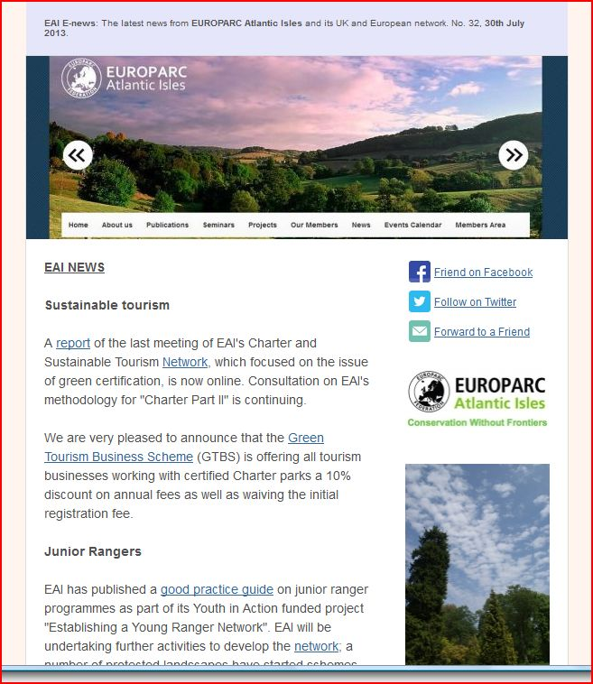
E-News
Notes:
E-News bulletins are issued regularly containing news from EAI, the EUROPARC Federation, information important to protected areas from across the UK and the European Union, including policy developments, publications, consultations etc, diary dates, funding opportunities.

Slide 16
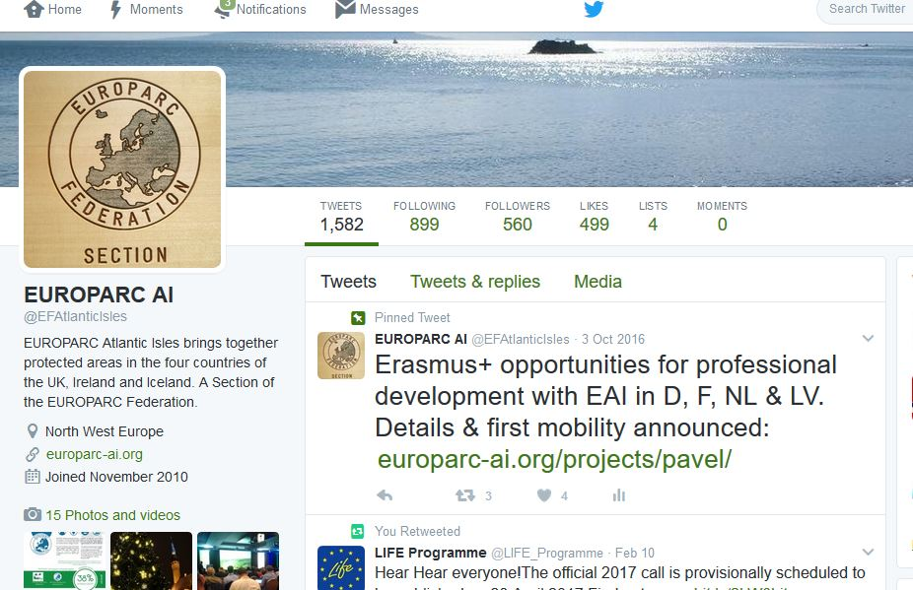
Twitter
Notes:
Twitter is an excellent way of both acquiring and disseminating information.

Slide 17
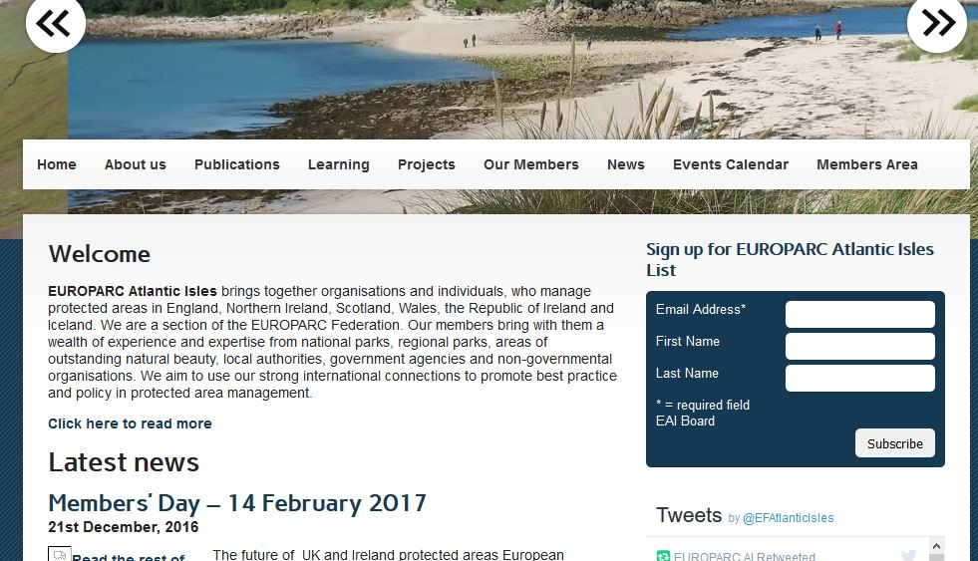
europarc-ai.org
Notes:
The EAI website is based on Wordpress, which is easy to maintain. It is possible for people to sign up for E-News. Thanks to the Twitter feed news items and references can be right up to date.

Slide 18
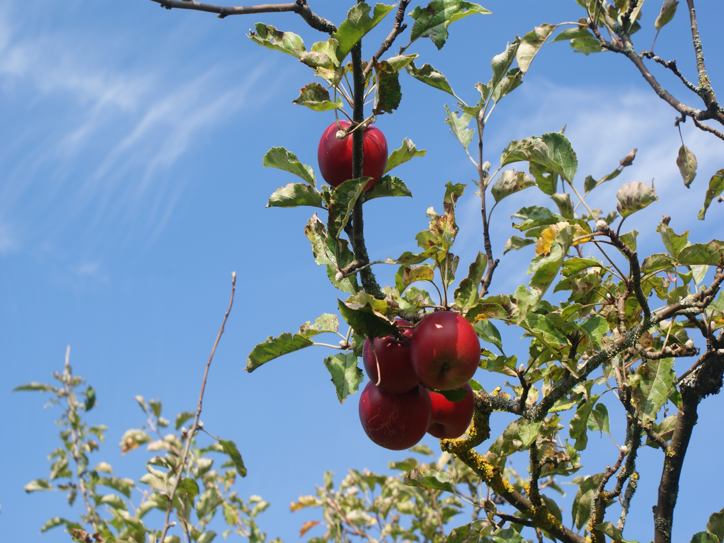
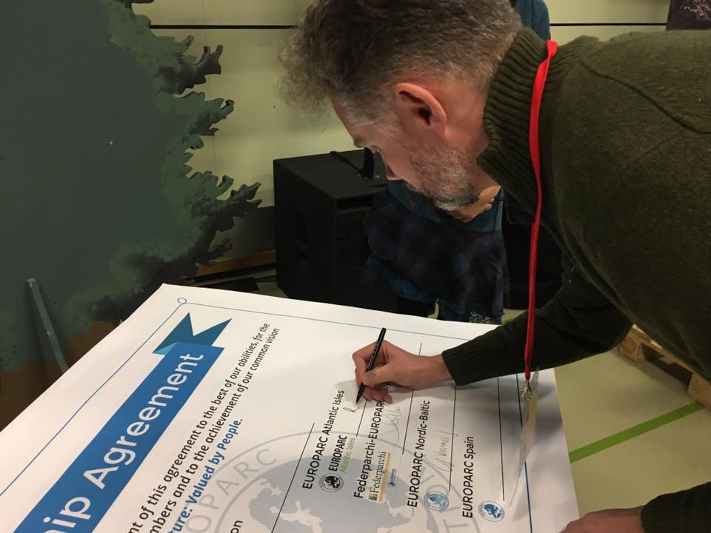
The Federation
Learning and working with European colleagues
EUROPARC Federation strategy
Partnership
Nature Parks in Europe

Slide 19
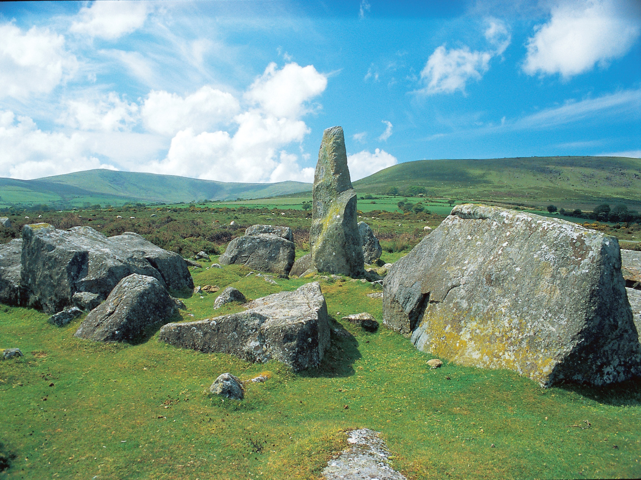
Our development
Fragmented set of umbrella and campaigning organisations
Member needs and aspirations
Resources
Brexit
Importance of European & international cooperation

Slide 20
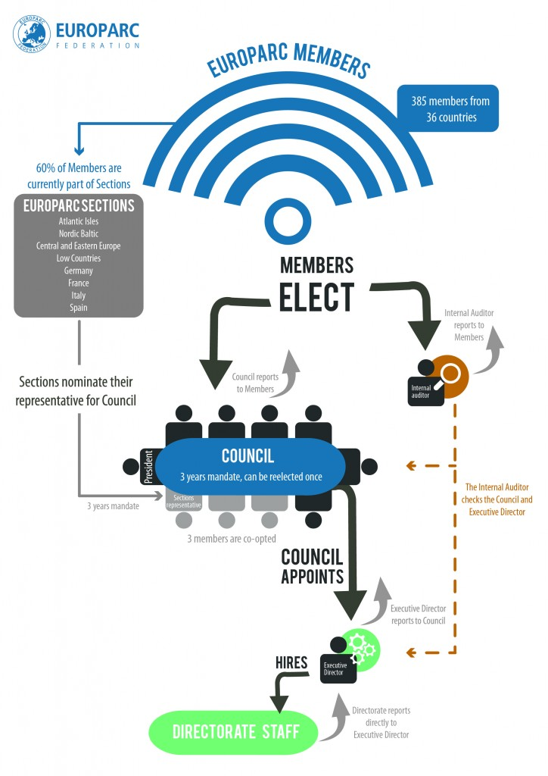

Slide 21
Further Information
www.europarc-ai.org
@EFAtlanticIsles
facebook.com/EUROPARC.Atlantic.Isles
www.europarc.org
anita.prosser@europarc-ai.org
Photographic Acknowledgements: Thanks to Cotswolds Conservation Board, Pembrokeshire Coast NPA, Clyde Muirshiel Regional Park, Forest of Bowland AONB, Causeway Coast and Glens Heritage Trust, Chilterns Conservation Board, Mendip Hills AONB, Richard Blackman.
Notes:
There are a number of ways to find out more about EAI and the Federation.

