Slide 1
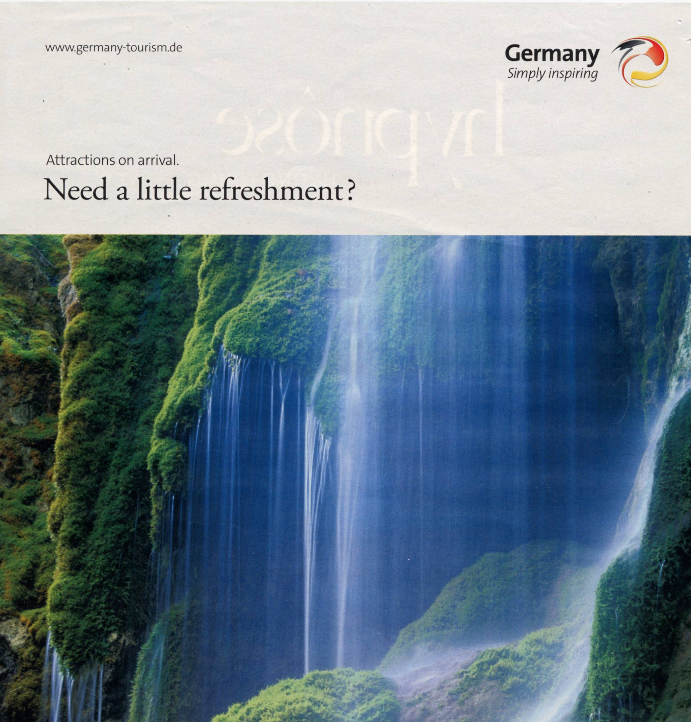

Slide 2
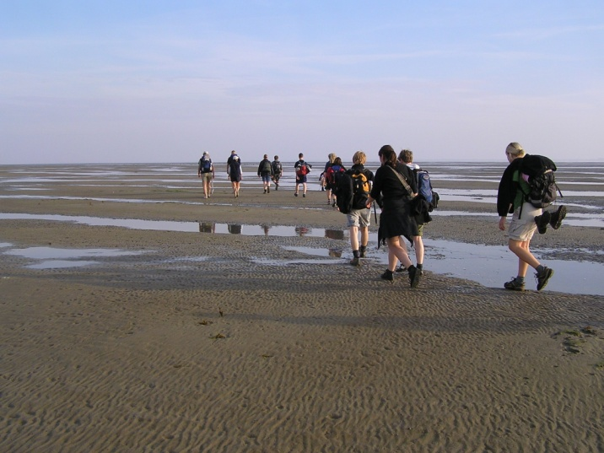
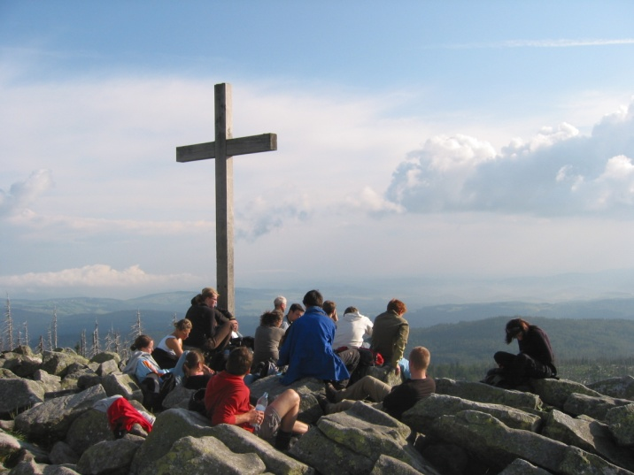
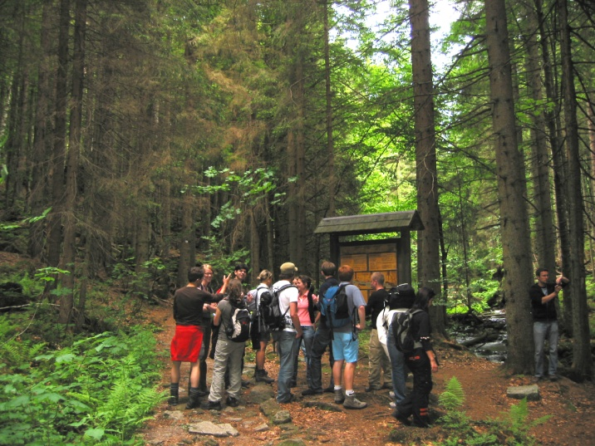
Economic Impacts of National Parks
–
Experiences from Germany

Slide 3
Agenda
National Parks as tourist attractions
Research design and methodology
Results from six national parks in Germany
Conclusions

Slide 4
Protected areas: the economic perspective
Economic Value of Protected Areas
USE VALUES
NON-USE VALUES
Direct use values
Indirect use values
Option value
Existence value
Bequest value
Tangible assets:
Tourism/Recreation
Agriculture, Forestry, Wildlife harvesting
Intangible assets:
e.g. Image building
Climate influence
Carbon sequestration
Watershed protection
Biodiversity
Genetic diversity
Aesthetic Landscapes
Rare Species
Source: adapted from Munasinghe (1992): 229
Notes:
In principle national parks are a kind of public good characterized by its non-excludability as well as its non-rivalness, i.e. it is not possible to exclude an individual from its consumption. Furthermore there does not exist any process of price-building in the market for these goods as it is common for private goods (e.g. clothing, furniture). Hence it is difficult to determine the financial value of public goods, e.g. of a national park.
Economic values of national parks comprise different components: use values and non-use values. The former are characterised by the dependency of their revenues on the direct ‘utilisation’ of the reserve like forestry. Use values can be further distinguished in three types of values: The so-called existence values are closely associated with the intrinsic significance of nature. They reflect the benefit of knowing that the national park exists even though the probability of visiting the protected area or getting direct use of it in another way is quite low. Rather similar are the intentions of the bequest values, which refer to the will of some people to protect e.g. special natural phenomena for future generations. At last the option values are also related to the future possibilities of using national parks respectively their resources, e.g. because of its biodiversity as an untested gene pool for pharmaceutical or agricultural products (WCPA 1998).
Within the use values a distinction has to be made between direct and indirect ones: While the latter comprise primarily ecological functions like e.g. avalanche or watershed protection, which are usually unmeasured by any market, the former are of particular interest for a local economy. Amongst others they include activities such as agriculture, hunting, recreation and tourism – values derived from the direct use of a national park. The focus of the following case study will be on this last issue, i.e. on the direct use values and especially the economic effects created by tourism investigated in terms of a value-added-analysis.

Slide 5
National parks as attractions
guarantee for authentic nature and wildlife experience
are rare and represent natural heritage
National Parks
create a positive image for a region
cannot be imitated because of their legal status
Can be seen as unique selling propositions (nucleus)
are used in the globalized tourism market as attractive brands (marker)
Conceptualized following Leiper 1990, Hannemann/Job 2003, Metzler 2007, Wall Reinius/Fredman 2007
Notes:
Why are national parks tourism brands? National parks (Hannemann/Job 2003)
guarantee for authentic nature and wildlife experience
are rare and represent national natural heritage
cannot be imitated because of their legal status
create a positive image for a region
Therefore, they could be seen as unique-selling-propositions (USP) or - to use the terminology introduced by Leiper (1990) – as a “nucleus”. A nucleus is a central element that might be a feature or characteristic of a place that a tourist considers visiting or actually visits.
Furthermore, national parks are used in the globalized tourism market as attractive brands which means that area protection functions as a marker. Markers are informative elements on which the trip motivation relies.
Wall Reinius and Fredman (2007) state that through a designation as national park the sight gets a name (label), the name is a marker and this name makes a distinction between similar phenomena (in this case between nature and nature). The name of the natural site (the marker) affects the tourists’ perception of the area and gives certain connotations and this can act as a generating marker for the person to set off the specific area.
Consequently, national parks could be the main visitor attraction in a destination; its brand can serve as symbol for the whole region and its management is an important actor and partner for the other tourism entrepreneurs (hoteliers, gastronomes, tour operators etc.)
In general, the potential for regional development is mainly based on the brand character of national parks and its scarcity on the market. The designation of national parks in Germany was often linked to regional economic promotion, especially in rural areas with economic weakness and high unemployment rates.

Slide 6
Research questions
How many tourists visit German national parks?
What is the role of German national parks as tourist attractions?
What are the economic effects generated by tourism in German national parks?

Slide 7
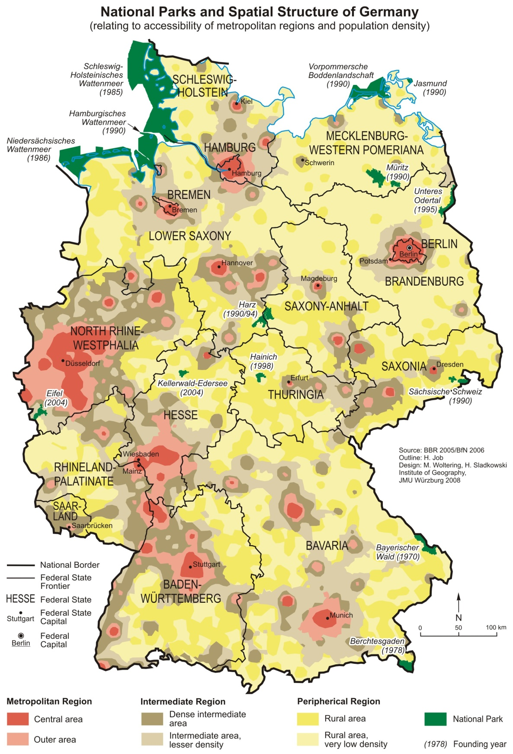
National parks and spatial structure
Type 1 (traditional tourist destination with
no specific national park orientation)
  Berchtesgaden
  Harz
  Lower Saxony Wadden Sea*
Type 2 (national park destination strongly developed)
  Bavarian Forest
  Schleswig-Holstein Wadden Sea
  West-Pomeranian Boddenlandschaft
Type 3 (averagely developed national park destination)
  Eifel
  Jasmund
  Müritz
  Saxon Switzerland
Type 4 (below average developed national park destination)
  Hainich
  Kellerwald-Edersee
  Lower Oder Valley
(*special case: Hamburg Wadden Sea)
Source: Job et al. (2009): 54-56
Notes:
In Germany the size of the 14 national parks ranges from 3,000 up to nearly 450,000 ha (including water area and tidelands), covering only less than 1% of terrestrial territory. Their share of the strictly protected core zone varies considerably between 10.7 and 91.5%.. Taking the figures from official tourism statistics in all national park destinations far more than 26 million overnight stays were counted in 2004. The tourism intensity is highly variable ranging from 178 to nearly 10,000 overnight stays per 100 inhabitants – that does not imply that all tourists are attracted as visitors by these national parks.
German national parks are relatively young. Being the prototype, in Bavarian Forest the idea to implement a national park was realized in 1970 only; Eifel and Kellerwald-Edersee were proclaimed in 2004. As the map shows, Germany’s national parks are mainly located in peripheral regions with low population density and economic power, either squeezed to the country’s borders or located in remote highlands.
When looking at the management of national parks and trying to compare national to international levels, important differences are obvious. As defined by German environmental law IUCN criteria differ from national parks targets. In both cases the protection of nature, ecosystems and resources is of central importance. On an international level though, tourism and recreation are stressed as a main aim: “protected area management [is] mainly for ecosystem protection and recreation” (IUCN 2003). This is not the case in Germany, where the subordinate targets “environmental education” and “experience of nature” are stressed instead. Recreational use is of minor importance (BNatSchG 2002, §24). This contrasts to the status of national parks in New Zealand where they are the main pull factor for incoming tourism as “…places that have been set aside for their intrinsic worth and for the benefit, use and enjoyment of the public…” (DOC 2005). The emphasis is given to tourism in this context which points to the backward development and inferior status that is still ascribed to national park tourism in Germany.

Slide 8
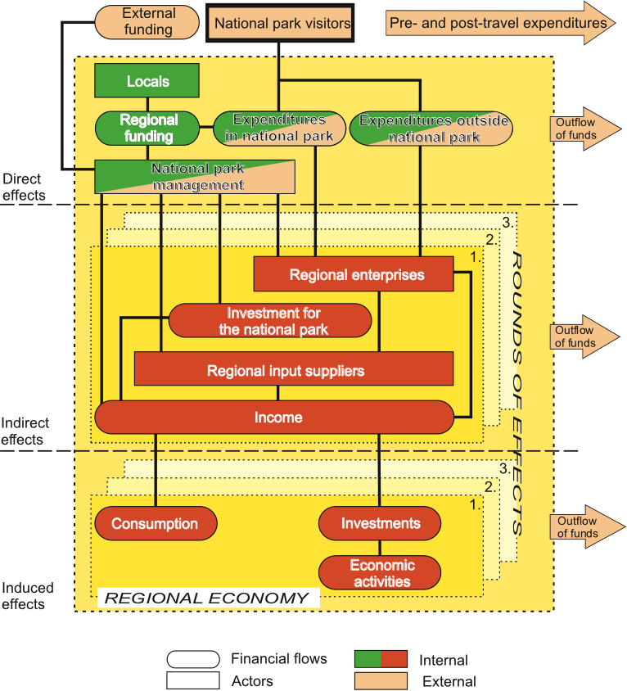
National parks within the regional economy
Source: adapted from Metzler 2007: 55
Notes:
A main step in economic impact analysis of national parks is to model the regional economy in order to give estimations of the magnitude of the impact. Figure 2 displays that the expenditures of tourists are seen as external injections into the regional finance flows, setting into action economic processes over different rounds. This process causes so-called multiplier effects, meaning that income originating from tourist expenditures not only benefits enterprises and workers directly receiving the expenses, but also showing indirect and induced income effects in supplying enterprises. Altogether the direct, indirect and induced effects result in a higher total income than in the initial round. Value-added studies concentrate on the first round (direct) effects. In focus is the added value, which is defined as the amount of turn over that is used as wages and earnings. This means that supply-side studies are necessary or third-party data is used that deliver the share of wages and earnings in relation to turn over in the relevant sectors in which tourist expenditures may occur. The effects of tourism on the Swiss National Park were estimated using this method. Küpfer (2000) uses data of a previous study for the added value quote and calculates a gross added-value of US$, 7.7 million translating into 120 income equivalents.
The application of input-output analysis or similar advanced research methods fail as a result of non-existing appropriate premises like e.g. regionalised input-output-tables and the associated prohibitive expensive data gathering. Because of missing regional data for an accurate Input-Output analysis in Central Europe up to now the impacts of national parks have been assessed on the basis of gathering data on a bottom-up scale only. The focus of the following case study will be on this issue, i.e. on the direct use values and especially the economic effects created by tourism investigated in terms of a value-added-analysis in two German national parks.

Slide 9
Survey design
countings
visitor number
short
interviews
Destination survey
visitor structure
gross turn-over
long
interviews
expenditure
motivation
Countings provide estimation on total number of visitors
Short interviews comprise true random sampling
Long interviews as intercept face-to-face survey (expenses, knowledge of protection status and motivation)
Notes:
In short, when it comes to evaluating economic impacts of Protected Areas, three data pools are necessary:
data on visitor numbers in different categories (day trippers, overnight visitors),
expenditure data and
a model for multiplier estimation.
Building up all three data sets can be very expensive and may well exceed cost and time budgets for the evaluation. Hence, it is reasonable to seek for alternative data sources. For the multiplier estimation there is a clear consensus that multipliers should not be transferred to other regions as they depend very much on regional economic structures in all probability not existent in others. Therefore sound project-specific calculation of the multipliers is an absolute must. On the other hand extensive primary surveys can be avoided if third party data is available for expenditures and visitors. Nevertheless, using such data has drawbacks. One critical factor of the research is the total number of guests visiting the parks.
One critical factor of the research is the total number of guests visiting a national park (both day trippers and tourists). In Germany no access limitations for national parks exists. Therefore reliable figures about visitor numbers are hard to assess. At the moment only unsatisfying approximate estimates can be obtained. Especially, for statistical purposes this fact aggravates sound analysis as the basic population is unknown. To solve this problem a random sample survey that is obtained by seasonally distributed counts and short interviews at different sites within the national parks accounting for possible activities is advocated. Moreover this method covers the ratio between day trippers and overnight staying tourists. The results of the counts in combination with the findings of the short interviews enable a reliable estimation of the touristic turnovers on the basis of the daily expenditures – surveyed in the long interviews – to all Park visitors. Basis for weighting of the results are temporal, spatial and structural factors as well as parameters caused by the weather.

Slide 10
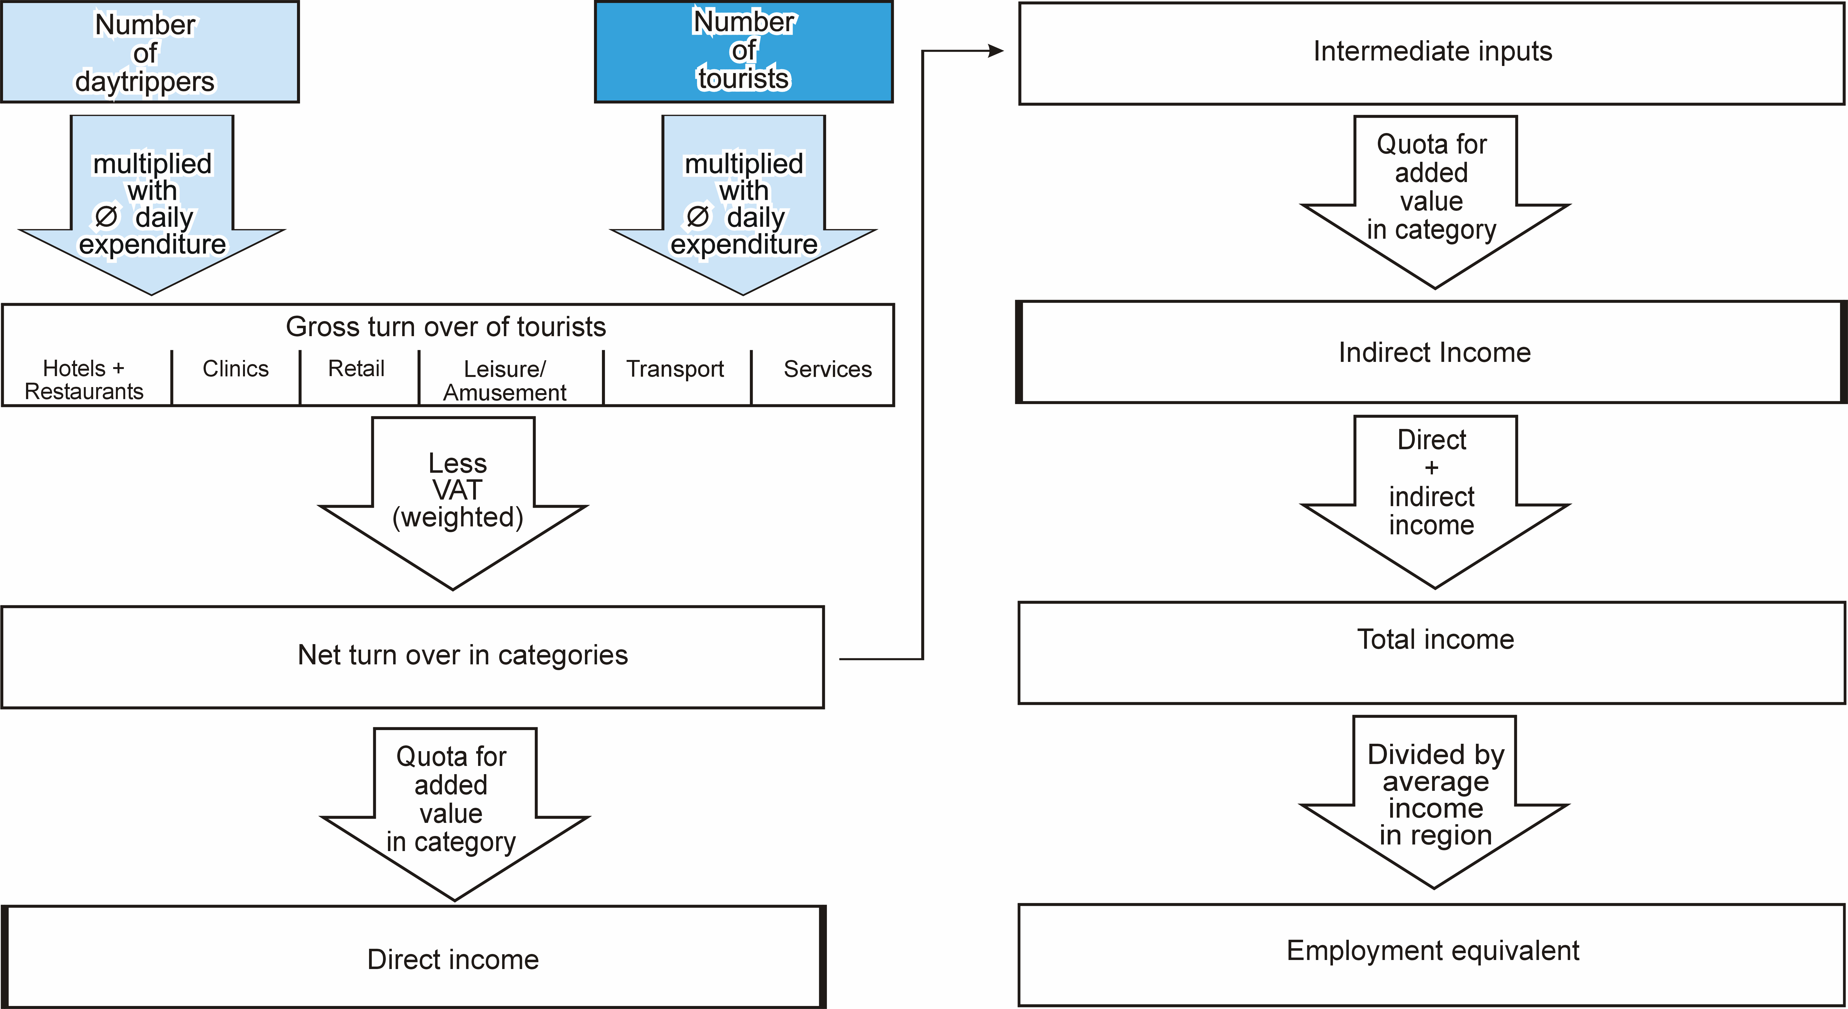
Calculation of income and employment effects
Multi-plier
Multi-plier
Notes:
Altogether eight steps are necessary to calculate the economic impact in terms of income equivalents with the findings of the different surveys: By multiplication of the visitor number and the average daily expenditures (differentiated by the varied target groups) the gross turnover of all park visitors can be calculated. Afterwards these total revenues are analysed by the different profiting sectors with their special VAT and value added rates. Thus it is possible to identify the importance of different visitor groups for a national park. The next step is to estimate the net turnover by subtraction of the VAT from the gross turnover. The direct income of the region (i.e. wages, salaries and profits) derives from the multiplication of the net turnover and the respective value added rates. The indirect effects on income of preliminary businesses have also been calculated in a separate step. The sum of the direct and indirect income effects is the added value within a region and measures the total impact on regional income. At last to get the income equivalents the total income effects have to be divided by the average regional social income per person. This results in an indicator describing the hypothetical number of individuals who could live on the basis of the income created by tourism in a national park.

Slide 11
Visitors with high national park affinity
“Do you know whether this area enjoys any special protection?”
Example: Bavarian Forest
Yes
(86.1%)
No
(13.9%)
“Do you know whether this region is a national park?”
Yes
(97.4%)
No
(0.3%)
“How important was the existence of the national park in your decision to come to this region?”
Important
or very important
(54.7%)
Less important
or unimportant
(44.6%)
45.8% = share of visitors with high national park affinity
Other visitors
Notes:
Data for the remaining variables were collected through on-site visitor surveys in the six national parks in 2004 and 2007. In total 78 064 face-to-face interviews were conducted of which 67 586 were short interviews in which only the duration of the stay, visitor type (day-tripper vs. overnight visitor) and the type of accommodation as the most important determinants of tourist expenditure (Kastenholz 2005: 563f.; Fredman 2008: 305f.) were recorded. The remaining 10 478 long interviews focused on the structure and size of tourist expenditure by economic sectors and the affinity to the national park. The share of visitors with high national park affinity was defined according to the following decision tree. As you can see for the example of the Bavarian Forest, the share of the core group of tourists with a high national park affinity is about 46 % of all tourists.
Census points were selected in cooperation with national park management to coincide with the main access points to the national parks so as to record park visitation. In every national park, 20 census days were chosen to reflect variations in visitation by season, day of the week and weather conditions in order to obtain representative visitation data for the whole year.

Slide 12
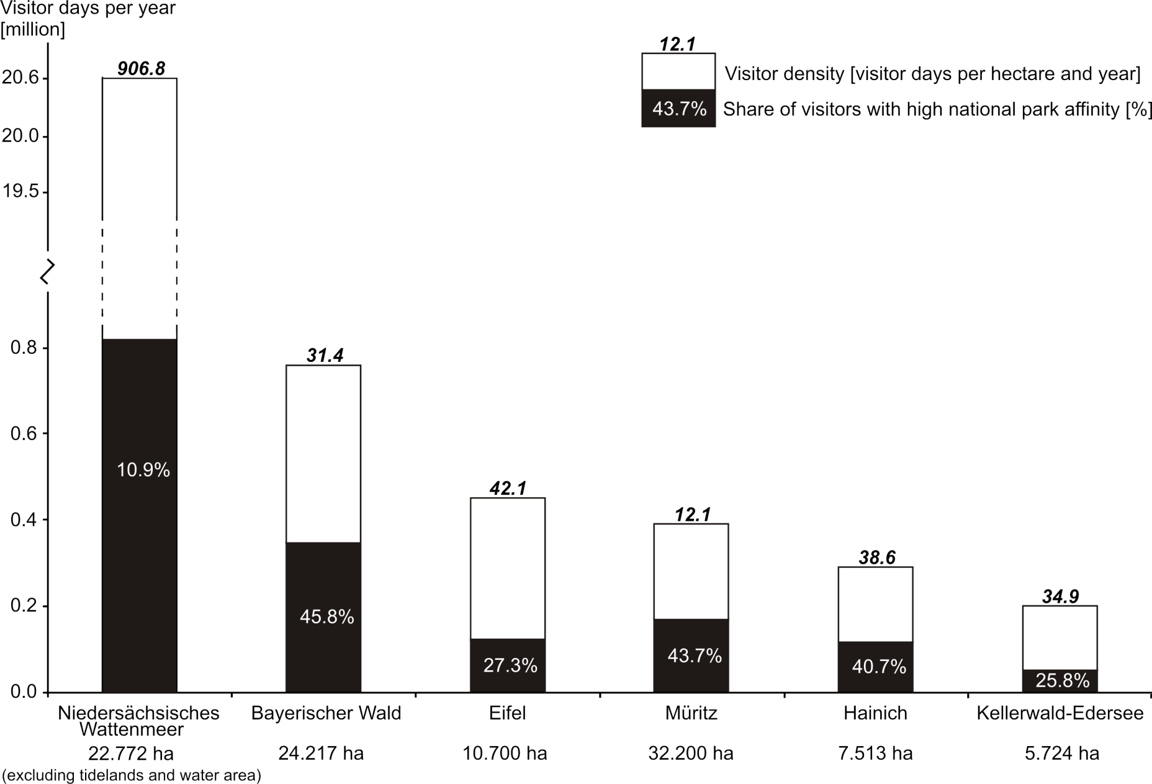
National park affinity, visitor days, visitor density
Source: Mayer et al. (2010): 76
Notes:
With a total of more than 20 million visitor days in 2007 Niedersächsisches Wattenmeer received almost 10 times more visits than the rest of the sample combined and more than 30 times more than Bayerischer Wald as the immediate runner-up (Figure 2). National park affinity, however, was lowest in Niedersächsisches Wattenmeer, reaching only 10.9%, whereas Bayerischer Wald at 45.8% was at the high end of the scale, closely followed by Müritz (43.7%) and Hainich (40.7%).
At more than 900 visitor days per hectare and year, visitor density is also considerably higher in Niedersächsisches Wattenmeer than in any of the other reserves. It surpasses the value of Müritz, the reserve with the lowest visitor density, by a magnitude of 75. The other four reserves receive between 30 and 45 visitor days per hectare and year.

Slide 13
Economic impacts
Italics: tourists with a high national park affinity
 | Bayerischer Wald | Eifel | Hainich | Kellerwald-Edersee | Nds. Wattenmeer | Müritz
Visitor days | 760,000 350,000 | 450,000 123,000 | 290,000 119,000 | 200,000 52,000 | 20,650,000 2,256,000 | 390,000 167,000
Share of daytrippers | 33 % 29 % | 76 % 70 % | 76 % 74 % | 59 % 58 % | 15 % 15 % | 39 % 37 %
Ø Daily expenditures per Person (EUR) | 36.57 38.70 | 19.31 22.77 | 17.25 18.85 | 19.48 20.14 | 50.37 51.32 | 34.32 33.80
Gross turnover (m EUR) | 27.8 13.5 | 8.7 2.8 | 5.0 2.2 | 3.9 1.0 | 1,040.2 115.8 | 13.4 5.6
Income (m EUR) | 13.5 6.5 | 4.3 1.4 | 2.5 1.12 | 1.9 0.52 | 525.1 58.2 | 6.9 2.8
Ø regional income per capita (EUR) | 14,387 | 16,217 | 12,132 | 18,335 | 17,335 | 10,918
Income equivalent (persons) | 939 456 | 265 85 | 206 92 | 105 28 | 30.289 3.360 | 628 261
Notes:
More than 85% of visitor days in Niedersächsisches Wattenmeer can be attributed to overnight visitors, whereas the same figure stands at only 24% for Eifel and Hainich. In general, overnight visitors mostly prefer private lodgings such as holiday apartments. Only in Eifel and Hainich does the share of visitors staying in hotels exceed the share of visitors staying in private lodgings. Staying overnight with friends or relatives is not uncommon. In Hainich more than 30% of all visitors stay with friends or relatives. Camping is also popular as an accommodation option, especially in Müritz where it reaches a proportion of 18.1% Across all national parks, spending for accommodation and catering makes up the largest part of the budget. For overnight visitors, it varies between 72.9% in the case of Bayerischer Wald and 83.0% in the case of Eifel.
With a mean daily expenditure of EUR 56.70 for overnight visitors and EUR 12.83 for day-trippers visitors were most generous in Niedersächsisches Wattenmeer, whereas Kellerwald-Edersee received the thriftiest visitors spending an average of EUR 6.88 on a day trip and EUR 37.25 if staying overnight. There was no significant difference between the expenditures of visitors with high national park affinity and normal visitors if we distinguished between day-trippers and overnight visitors. Visitors with high national park affinity, however, are significantly more likely to be overnight visitors and therefore have a higher overall expenditure. Due to the high proportion of overnight visitors Niedersächsisches Wattenmeer also had the highest mean daily expenditure with EUR 50.37 per visit. In contrast, Hainich received the lowest expenditure with only EUR 17.25 per visit.
Focusing on the overall economic impact, Niedersächsisches Wattenmeer took a clear lead with more than EUR 500 million created through tourism in the park, of which almost EUR 60 million are created by visitors with high national park affinity. Due to their higher share of overnight visitors, Bayerischer Wald and Müritz also performed reasonably well with EUR 13.5 million and EUR 6.9 million, respectively, for all visitors and EUR 6.5 million and EUR 2.8 million for those with high affinity. With a total income of less than EUR 5 million each, the remaining three national parks lagged behind. If we take into account the differing sizes of the national parks by calculating the spending density, Niedersächsisches Wattenmeer is still far ahead with a spending of 55 000 € per hectare and year for all visitors, but Müritz comes in last with an average spending of 420 € per hectare and year.
Between 32% and 35% of gross visitor spending is retained as direct income in all national parks. Another 16%, on average, is converted into indirect income. This translates into an overall retention rate of between 49% and 51%. About half of the gross tourist revenue is thus converted into income. The income retained from tourism in all national parks in our sample corresponds to an income equivalent of 32 432 in total (2 143 without Niedersächsisches Wattenmeer). Adjusting by national park affinity brings this figure down to an income equivalent of 4 282 (922 without Niedersächsisches Wattenmeer).

Slide 14
Conclusions
National parks have the potential to be major destinations gaining importance in German tourism, especially if marketing is enhanced (strong brand)
National parks can contribute considerably to regional economies, especially in peripheral and structurally weak regions
National parks do not only need eco-monitoring, but also socio-economic monitoring
Visitor and economic monitoring must be based on sound knowledge of visitor structure and correct sampling
Monitoring data should be used to establish benchmarking in tourism of national parks
Notes:
This study has been the first to present a comprehensive dataset on the economic impact of tourism in German national parks. The size of the economic impact is primarily a function of the total visitor days and the mean daily expenditure of national park tourists. Our results then suggest two main avenues for increasing the economic leverage of national parks: the first is quantitative upgrading by attracting more visitors and the second is qualitative upgrading by inducing visitors to increase expenditure. Qualitative upgrading could include measures to increase the share of overnight visitors or to enhance the quality and therefore the price of touristic services. It is this second avenue of qualitative upgrading which contributes to an ecologically responsible tourism while at the same time creating jobs and entrepreneurial income in local communities.
In order to achieve qualitative upgrading, however, German national parks need to move towards more professional visitor monitoring and marketing. Visitor monitoring must include a systematic and continuous survey of use levels and economic impact of tourism in national parks. As Eagles et al. (2000: 62f.) claim, it is politically dangerous not to have such a monitoring system: ‘senior politicians, government policy-makers, and business planners make decisions based upon the available information. Those sectors with weak or incomplete information risk being undervalued when policy, planning, and management decisions are made.’
Visitor monitoring is also a crucial tool in evaluating the effectiveness of visitor marketing. In this respect, the generally low proportion of visitors with high national park affinity leaves ample room for improving the position of national parks on the tourist market and promoting their truly unique selling proposition of unspoilt wilderness. The launch of a common brand name and marketing for German protected areas in 2005 was a first step in this direction. Because visitors with national park high affinity stay longer and therefore spend more money, this strategy is also a promising avenue for increasing the total economic impact of tourism in German national parks.

Slide 15
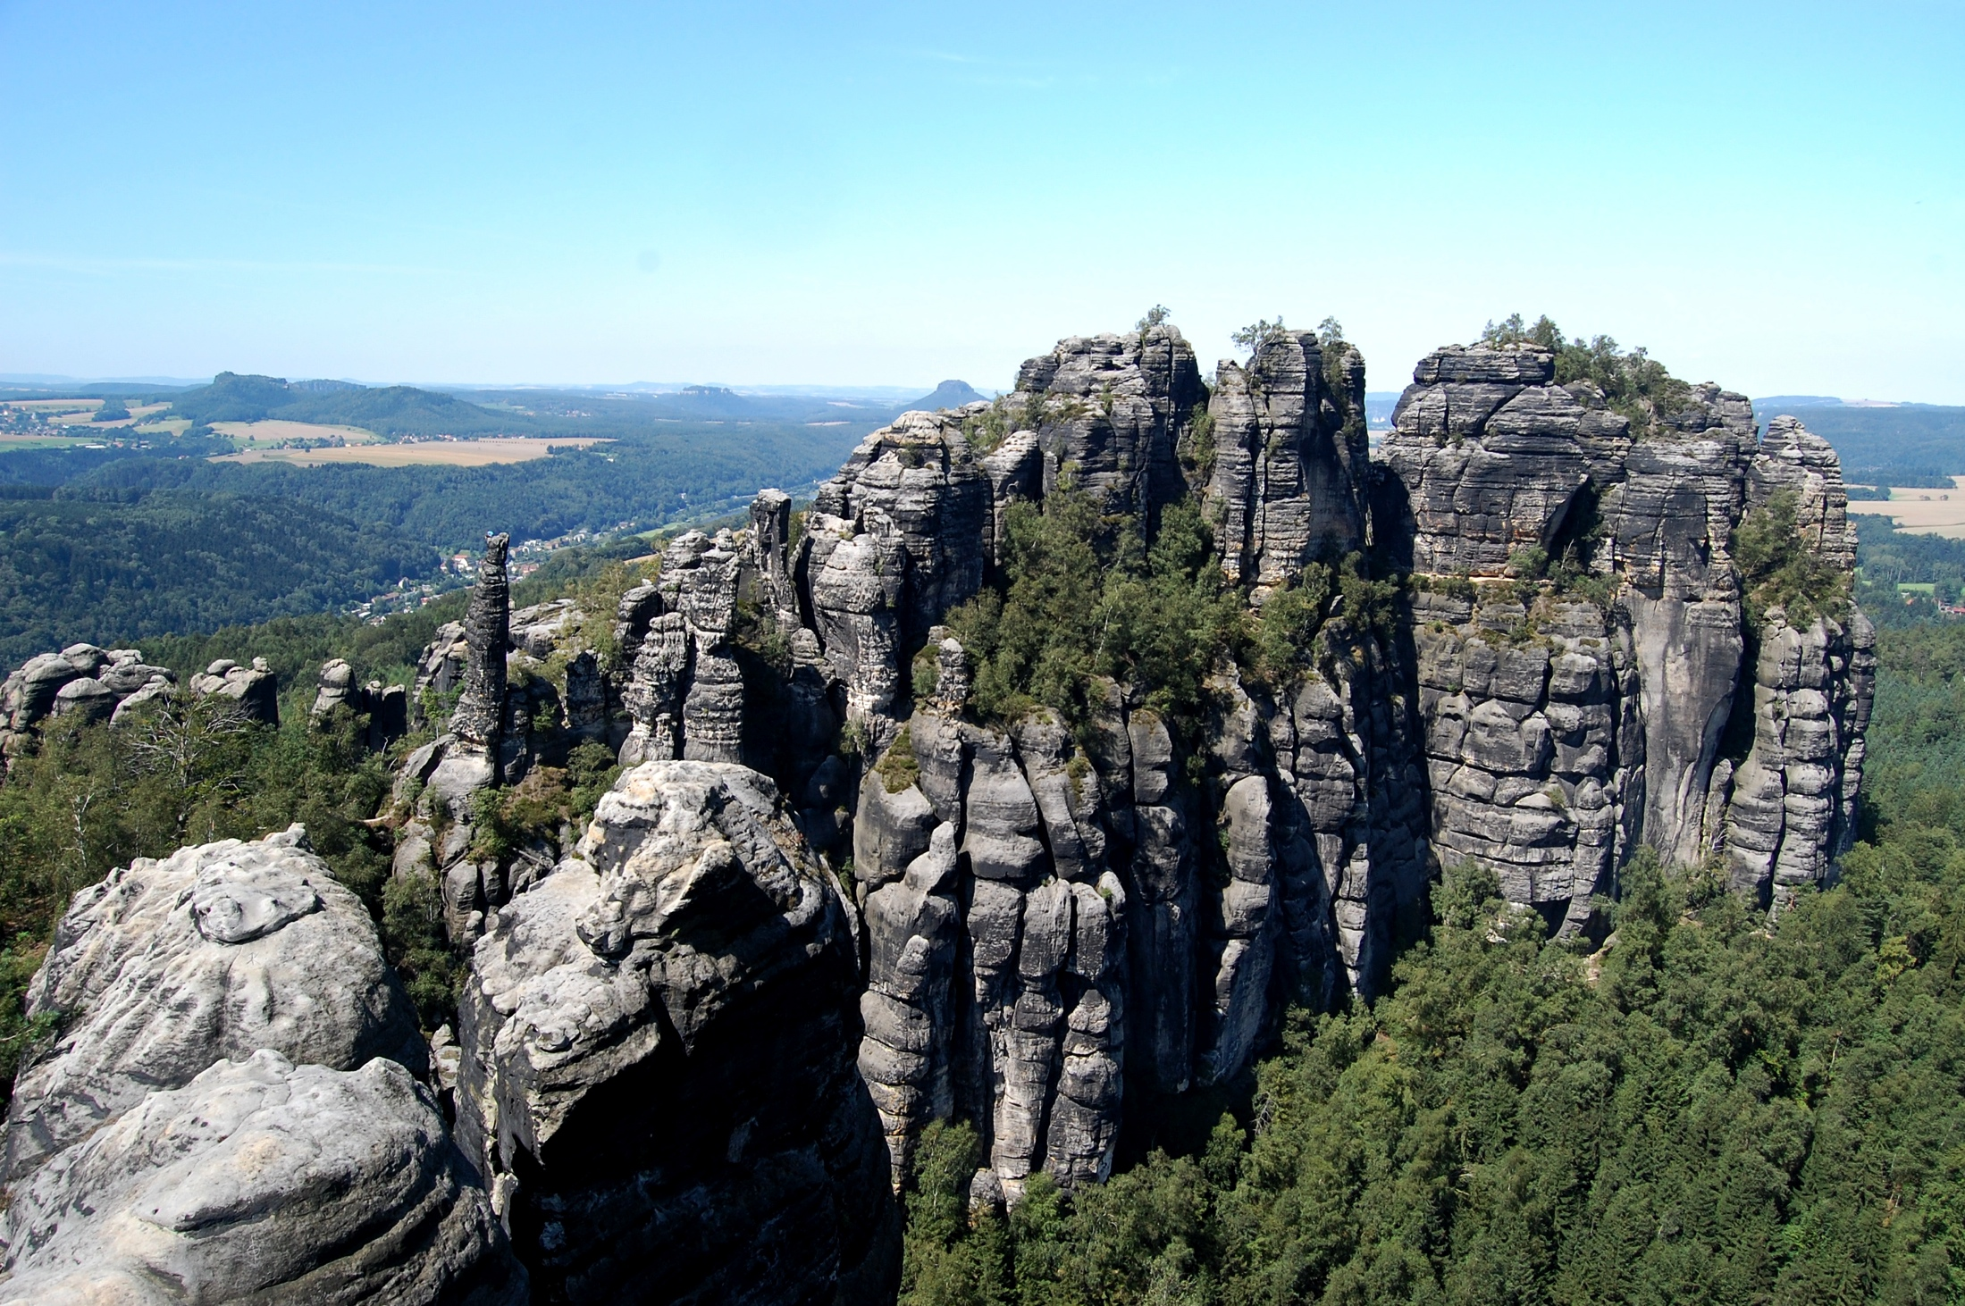
Thank you for your attention

